Slide 1
Seminar 1 Design of Informatics Systems

Slide 2
What is a model?
Simplifications or abstractions of some real elements or elemets that are being designed.
Highlights only those elements that are important for the analyst.
They are specified using precise graphical or textual notation, using a given symbols language.
A collection of images and text that has a meaning and is intended to represent something.

Slide 3
What is a model?
In software development models can be of several types:
Environmental models
Domain models
System specification models
System design models
The models are valuable because:
they are fast;
it is easier to change a model than source code.

Slide 4
Software development methodologies
Methodology
Process
Rules and guidelines
Vocabulary

Slide 5
Software development methodologies
Process: a set of activities that help to achieve the desired objectives;
Vocabulary: describes the process and the results obtained during its implementation;
Rules and guidelines: they define the quality of the process and of the outcomes.

Slide 6
Software development methodologies
The part of a methodology that can be standardized: vocabulary (notation).
UML (Unified Modeling Language) - common notation that can be applied to several methodologies.
It is very difficult to define a single process suitable for all types of projects
Exemple de alte notaţii standard

Slide 7
Methodology examples - 1
RUP (Rational Unified Process):
iterative and incremental process
Partial delivery of product releases at each iteration
Short delivery periods and frequent checks
Customer verifiable results
exhaustive process; it can become unmanageable
RUP customization requires a significant effort
OMT (Object Management Technique)
UML precursor
Use the concepts of object orientation

Slide 8
Methodology examples -2
XP (Extreme Programming)
agile development methodology
focuses on coding (standards, principles)
It argues that programmers work in pairs ("pair programming")
numerous discussion sessions during development
each iteration (1-4 weeks) has a functional outcome
reduced support for modeling
close relationship between customers and developers
lack of documentation

Slide 9
What is UML?
UML = Unified Modeling Language
Notation language for specifying, constructing, visualizing and documenting software systems.
Combines the best practices in diagram development in the last 50 years.
Standardizes notation, but does not specify how they are used.
It is not a methodology, it can be used as a vocabulary for methodologies.
It offers developers flexibility, while ensuring consistency.
Is a standard developed and maintained by the Object Management Group.

Slide 10
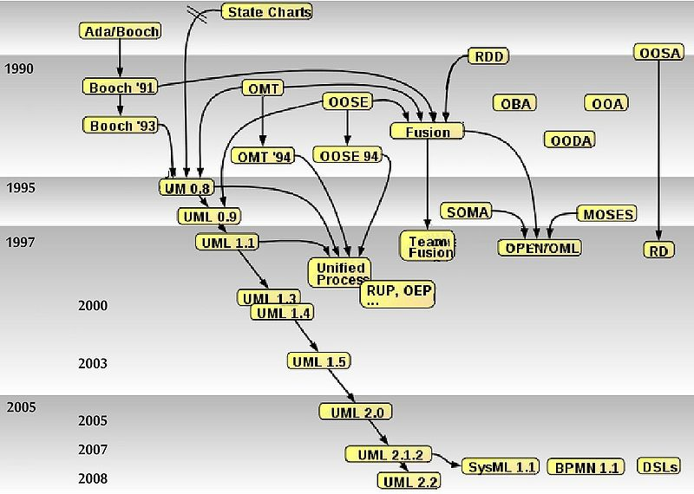
UML history
2011
UML 2.4.1

Slide 11
UML basic elements
Metamodel for object oriented modeling
Consistent set of definitions of concepts and the relationships between them;
Each element used in modeling is defined using a precise syntax (eg defining a class);
Support language for transmitting visual models between different tools;
It has a four-tier architecture.
Layer | Description | Example
meta-metamodel | Defineşte limbajul pentru specificarearea metamodelelor. | Concepte abstracte din care este derivat metamodelul.
metamodel | Defineşte limbajul pentru specificarea modelului. | Concepte: Clasă, Atribut, Operaţie, Componentă
model | Defineşte limbajul folosit pentru descrierea domeniului analizat. | Concepte: Student, Materie, Client, Produs, Comandă
User objects | Definesc informaţii despre obiectele domeniului analizat. | Exemple: Student #3456, Materia #0512

Slide 12
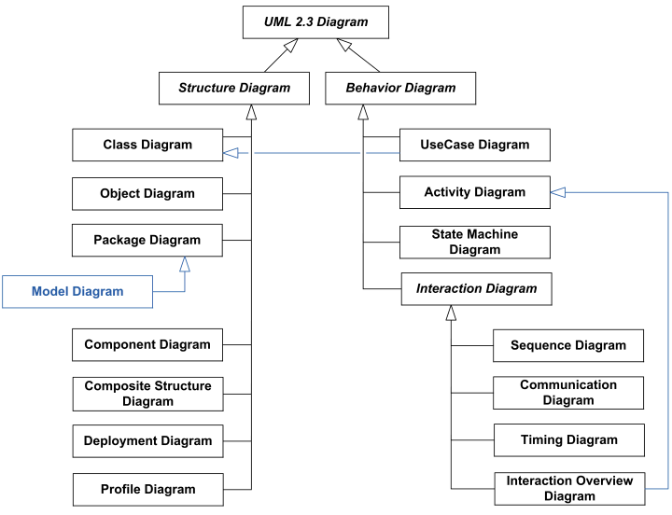
ElementUML basic elementse de bază ale UML
Diagram types

Slide 13
UML basic elements
3. Extension mecanisms
Stereotypes characterizes an element of the model or a relationship between elements (there are predefined stereotypes).
Comments (notes) offer additional descriptions of an element in the model.
Constraints limit the use of an element in the model.
Tagged values represet attributes defined for a stereotype.
Profiles customize the metamodel through special costructions that are specific to a particular field, platform or development method.

Slide 14
Perspectives on the system
Static
Diagrams:
Class
Objects
Composite structure
Componets
Deployment
Functional
Diagrams:
Use cases
Activities
Interacţiuni de ansamblu
Dynamic
Diagrams:
State
Sequence
Comunication
Time
Pachet diagram – structuring / modularization
Profile diagram - language extension

Slide 15
CASE tools - 1
CASE = Computer Aided Software Engineering
Necessity:
working with visual models can be tedious and time consuming
need for IT support when we want to maintain the integrity of the models
the ability to generate code

Slide 16
CASE tools -2
Basic functions:
Creating diagrams
Managing information regarding diagrams
Checking the consistency of the models
Creating links between models
Version tracking models
Code Generation
Engineering and reverse engineering

